Slide 1

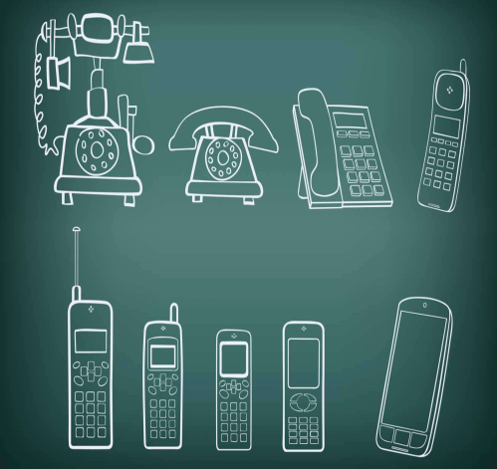

The evolution of wireless network technologies
By Wisam Siyamak
Outline:-
Definition of Wireless Network
1st, 2nd, 3rd, 4th Generations
Analyzing the Wireless Network Improvements
Conclusion

Slide 2
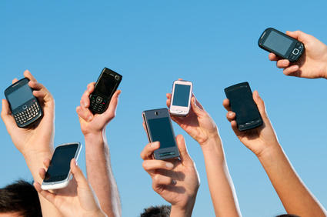

Wireless network technologies
(Techopedia 2015)
What is Wireless Network?
1G
2G
3G
4G

Slide 3
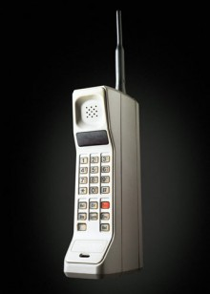
First Generation network
The First Generation (1G):-
Speed: 2.4 kbps
Voice Service Only
Disadvantages:-
Large Phone Size
Weak Security
(Maxwell 2013)
(Jain et al. 2014)
(Bliss 2010)

Slide 4
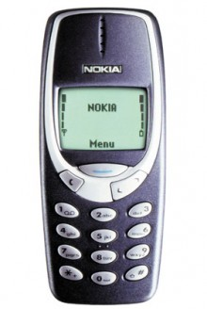
Second Generation network
The Second Generation (2G):-
Digital & Voice Services
Speed: 64 kbps
Disadvantages:-
Poor Voice Quality
Requires a Strong Signal
(Bliss 2010)
(Maxwell 2013)
(Jain et al. 2014)
(Bliss 2010)

Slide 5
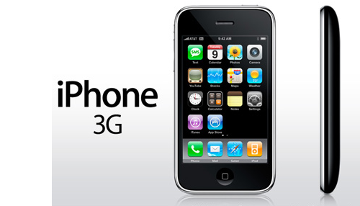
Third Generation network
The Third Generation (3G):-
Speed: 2,000 kbps
Video data, Internet.
Mobile Broadband
Disadvantages:-
Poor Battery Life
(Maxwell 2013)
(Aeyne 2013)
(Gonzales 2008)

Slide 6

fourth Generation network
The Fourth Generation (4G):-
Speed: 100,000 kbps
Wide Range of Coverage
High Security
Disadvantages:-
Limited Connectivity (Regions)
3G & 4G Price
(Viswanathan [No Date]; Maxwell 2013)
(Viswanathan [No Date])
(Mobilespace 2012)

Slide 7
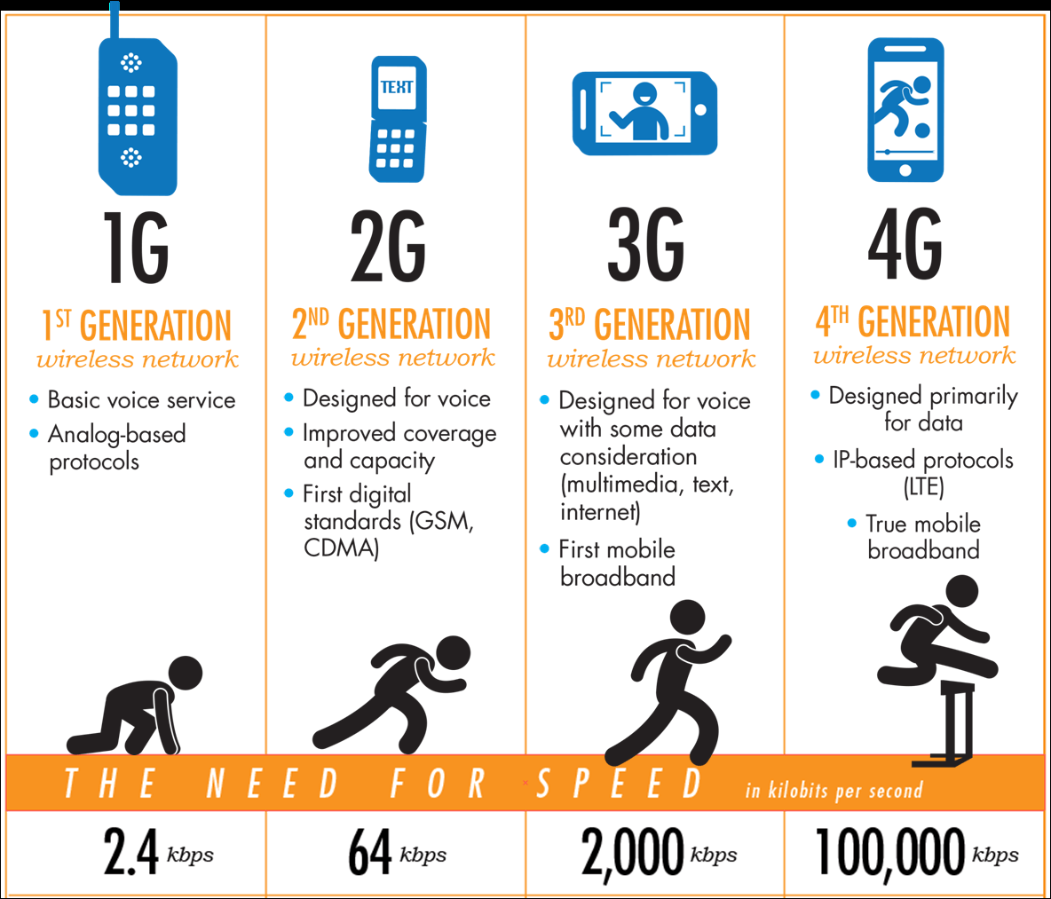
Analyzing the networks Improvement
(Maxwell 2013)

Slide 8
Conclusion
Developing Wireless Networks
More Benefits & Communicate Faster
Relying on Smartphones

Slide 9
References
Aeyne, 2011. Pros and Cons of 3G Internet Technology [online]. Internet Access Guide. Available at: http://internet-access-guide.com/pros-and-cons-of-3g-internet-technology/ [Accessed: 29 Oct. 2015].
Bliss, J. 2010. Sprint Announces World’s First 4G Phone, HTC Evo – We Announce What “4G” Means [online]. Available at: http://www.themarysue.com/htc-evo-what-does-4g-mean/ [Accessed: 25 Oct. 2015].
Gonzales, D. 2008. O2 to Offer Free iPhone 3G in UK [online]. Unwired View. Available at: http://www.unwiredview.com/2008/06/10/o2-to-offer-free-iphone-3g-in-uk/ [Accessed: 30 Oct. 2015].
Jain, V. et al. 2015. Overview on Generations of Network: 1G,2G,3G,4G,5G [online]. Available at: http://www.ijcta.com/documents/volumes/vol5issue5/ijcta2014050534.pdf [Accessed: 28 Oct. 2015].
Maxwell, R. 2013. 1G, 2G, 3G, 4G: The Evolution of Wireless Generations [image]. Available at: http://www.phonearena.com/news/1G-2G-3G-4G-The-evolution-of-wireless-generations_id46952 [Accessed: 26 Oct. 2015].
Mobilespace, 2012. 4G Makes Phones Quick Smart | Australia Mobile Space [image]. Available at: http://www.mobilespace.com.au/2012/02/4g-makes-phones-quick-smart/ [Accessed: 26 Oct. 2015].
Techopedia, 2015. What is Wireless Network? - Definition from Techopedia [online]. Available at: https://www.techopedia.com/definition/26186/wireless-network [Accessed: 24 Oct. 2015].
Viswanathan, P. [no date]. The Pros and The Cons of 4G Mobile Networks [online]. Available at: http://mobiledevices.about.com/od/carrierfaq/a/4g-Mobile-Networks-The-Pros-And-The-Cons.htm [Accessed: 25 Oct. 2015].

Slide 10

Thank You For Listening
Any Questions ?

